Slide 1


Predicting Customer Buying Behaviour
17/04/2023
85%
50%

Slide 2

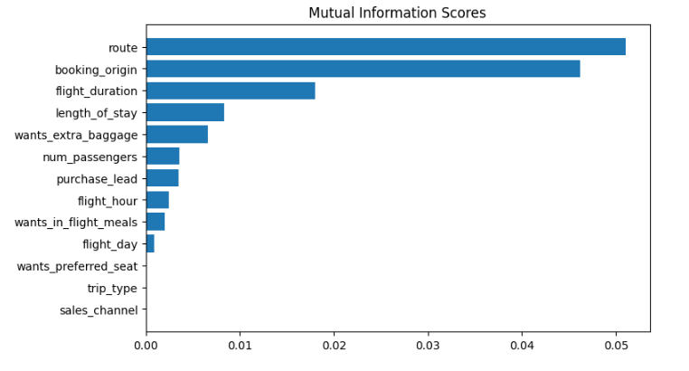
PREDICTIVE MODEL TO UNDERSTAND FACTORS THAT INFLUENCE BUYING BEHAVIOUR
The dataset was trained with Random forest classifier model and received
ACCURACY: 85.09
AUC score: 0.558
Upon investigating feature importance, we identified that the route, booking origin, flight duration, wants extra baggage, and length of stay are the top five features that have a significant influence on customer buying behavior.
However, we recognized the need to boost our model's AUC score to enhance its predictive capability.

Slide 3
Predicting Customer Buying Behaviour
THANK YOU

